Slide 1
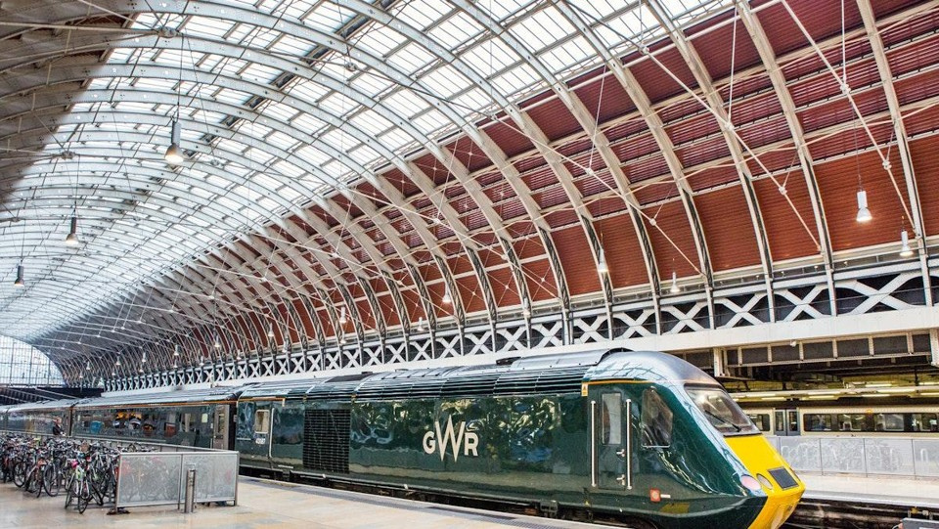

ANALYSIS OF
UK RAILWAY RIDES

Slide 2
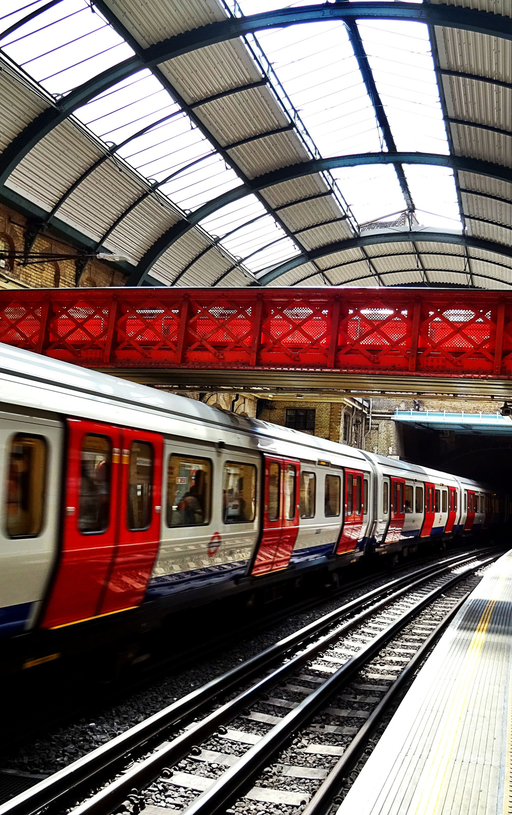
AGENDA
Team Members
Introduction
Data Overview
Data Cleaning Process
Data Modeling
Dashboard Overview
Key Findings & Insights
Recommendations

Slide 3

MEET OUR PROFESSIONAL TEAM
AHMED FAROUK
DATA CLEANING AND PREPROCESSING - VISUALIZATION
MOSTAFA AHMED
DETERMINE DATA ANALYSIS QUESTIONS AND SET RECOMMENDATIONS
KHALED ELFEKY
DASHBOARD AND VISULIZATION
MONA MOHAMMEDI
FINAL PRESENTATION AND BUSINESS INSIGHTS

Slide 4
PROJECT GOAL
PROJECT GOAL
DATASET
DISCRIPTION
Explore and visualize operational and sales data from railway journeys across the UK, using real datasets and interactive dashboards.
Records: 31,653 entries
Fields: 18 columns
Content: Covers train ticket transactions, including purchase info, journey details, delays, and refund requests.

Slide 5
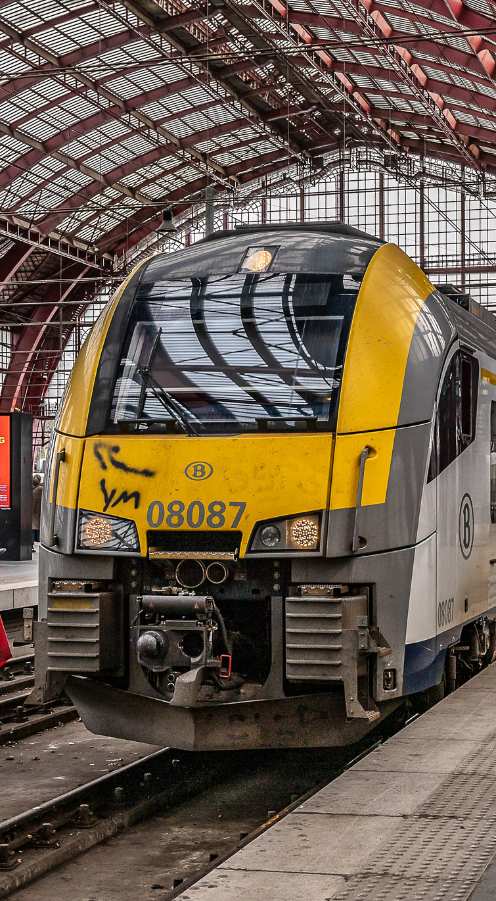
QUESTIONS
& ANALYSIS
•When and where tickets were bought?
•How much they cost?
•Which stations people traveled between?
•Whether the train was on time, delayed, or canceled?
•If a refund was requested
•And the reason for any delay

Slide 6
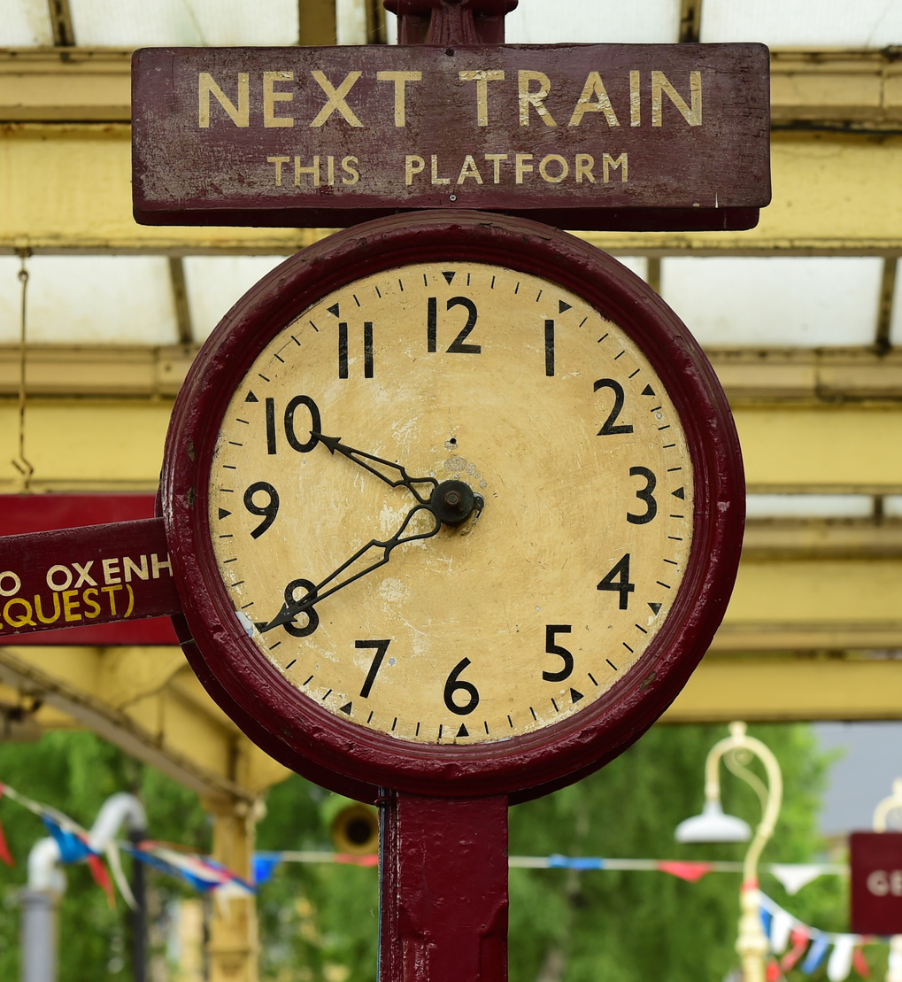
OUR BUSINESS PLAN
Main steps we follow:
PowerQuery
Data Cleaning
Model view
DAX
Dashboards (Overview, Operation, Sales)
Insights
Recommendations and insights

Slide 7
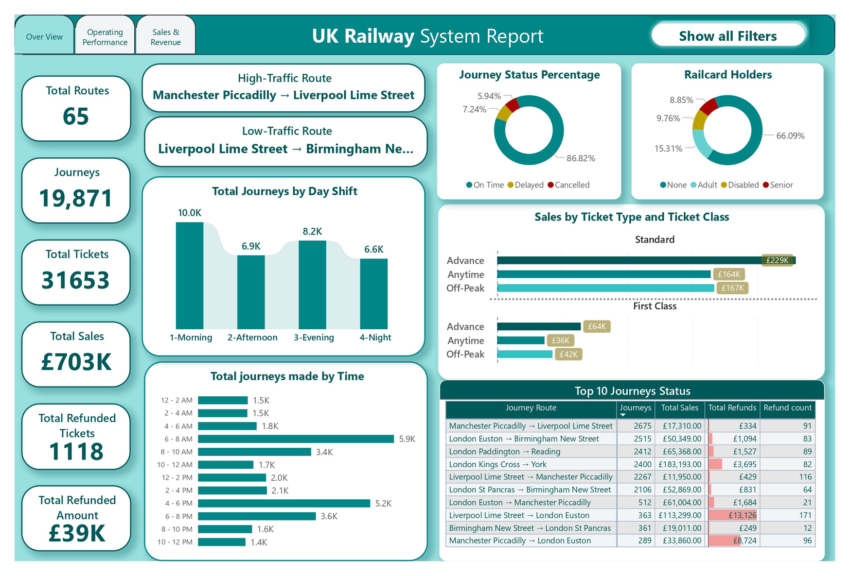

OVERVIEW

Slide 8
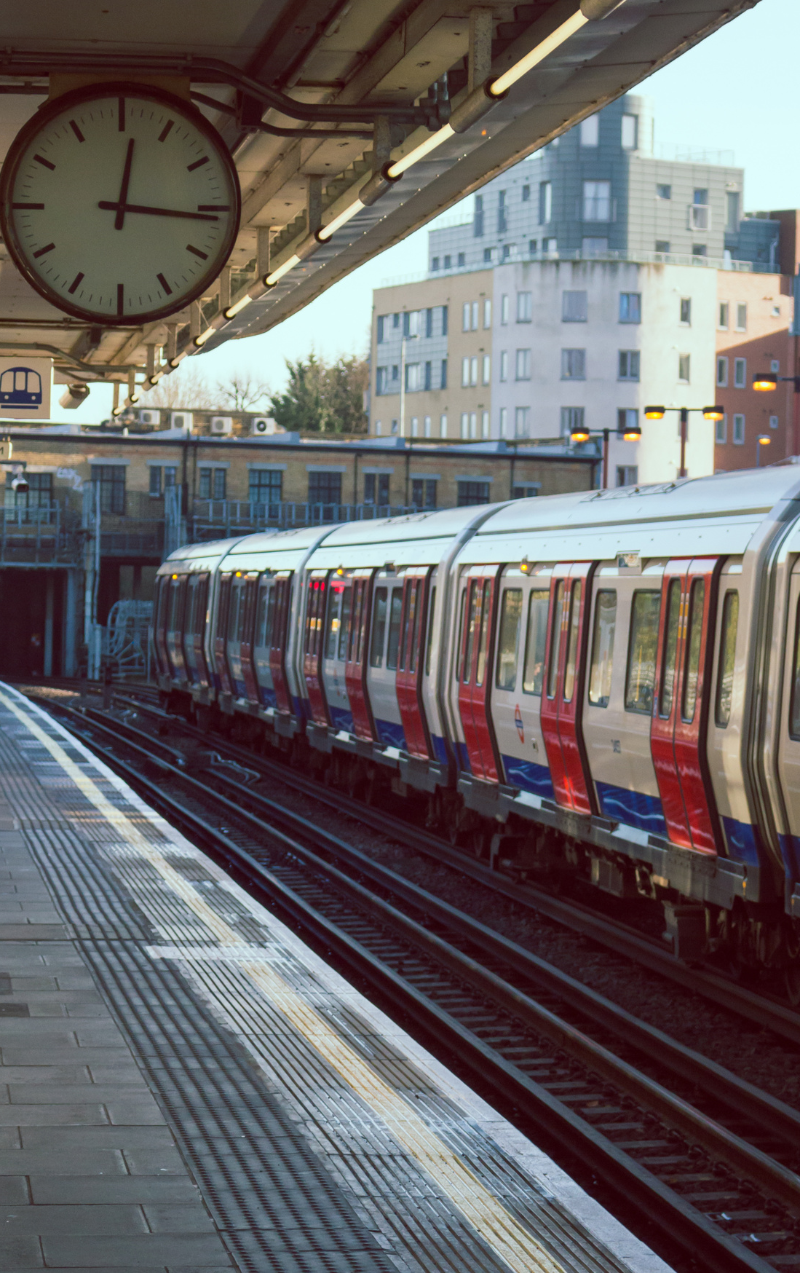
COMPANY
PERFORMANCE
Across 65 routes
Total Tickets sold 32,000 tickets sold
generating over £741K in total sales.
Only 86.82% were on time
While 7.24% were delayed, and 5.94% cancelled.
The busiest route and making high-traffic, with 2,675 journeys is Manchester to Liverpool route.
Total journeys per time slot:
Peak travel was from 8 AM to 10 AM, with nearly 6,000 journeys.
This helps railway operators plan staffing and maintenance windows more effectively."

Slide 9
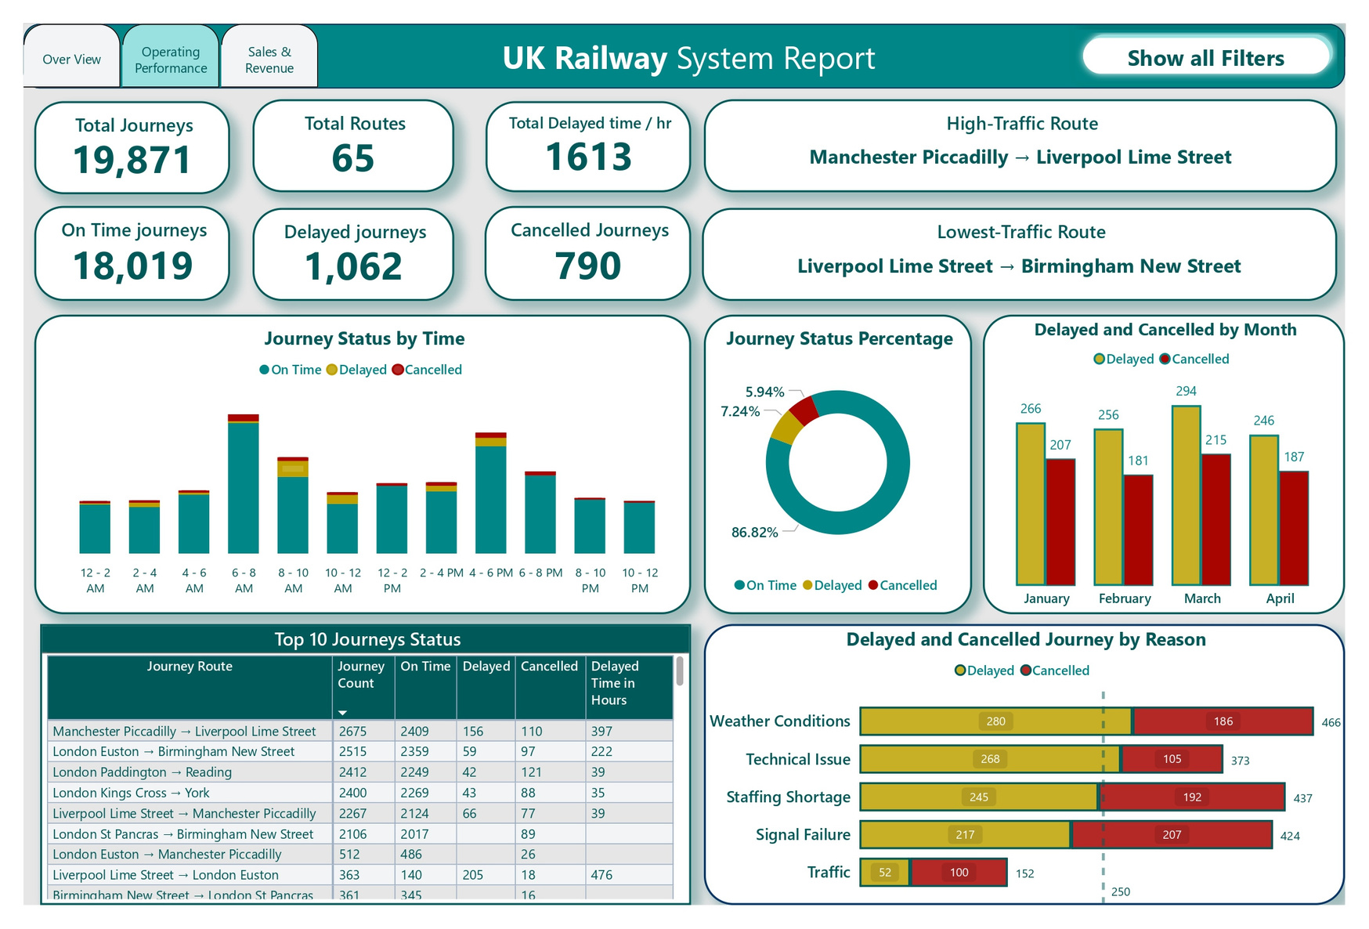
OPERATIONS
GOAL: ASSESS THE PERFORMANCE OF TRAIN JOURNEYS IN TERMS OF EFFICIENCY AND DELAYS.

Slide 10
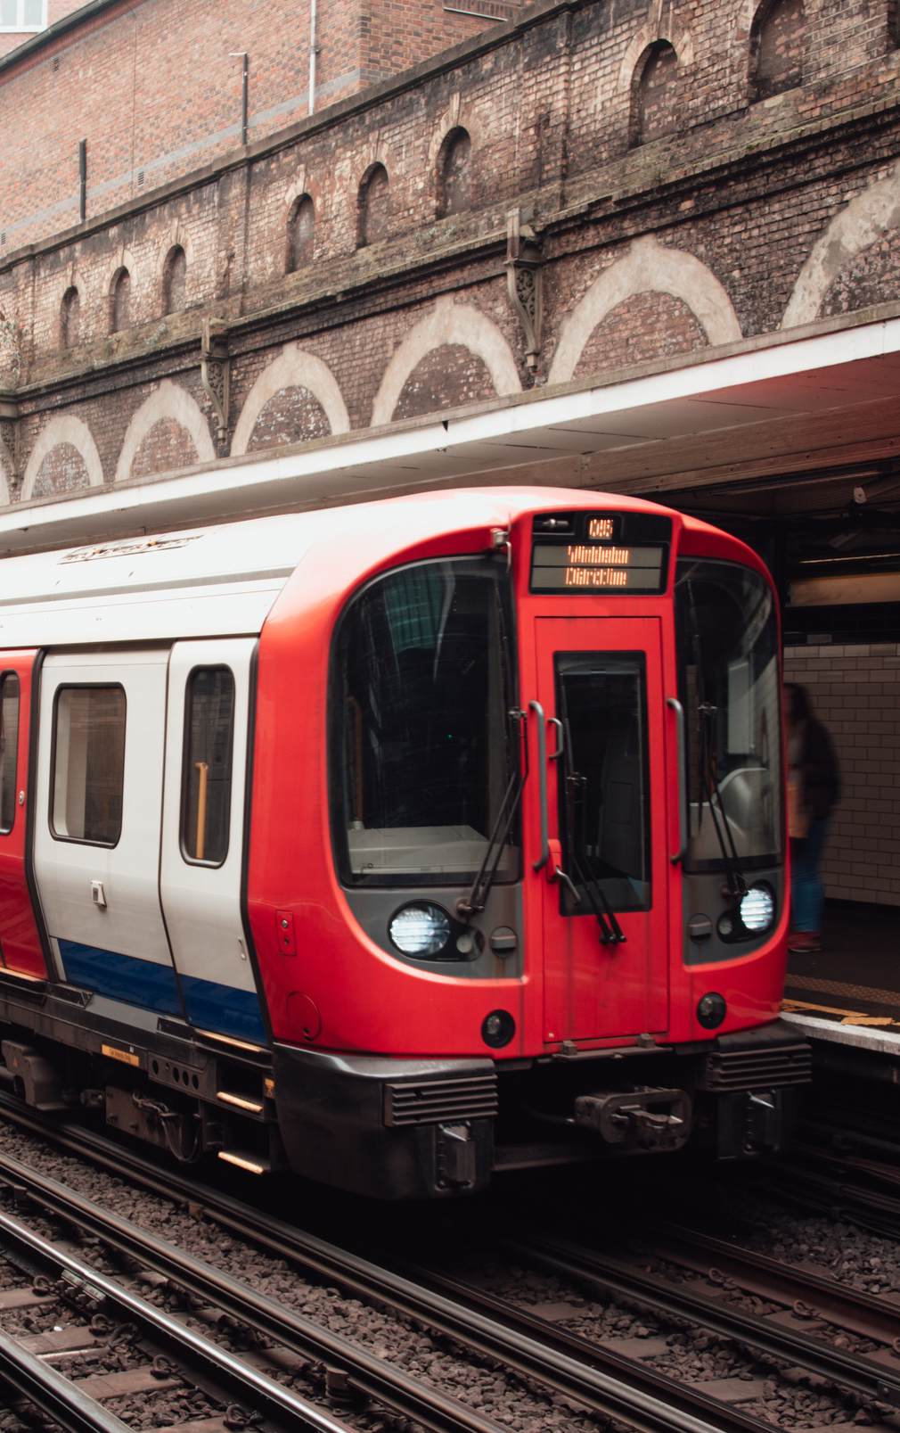
OPERATIONS
PERFORMANCE
A total of 1,613 hours were lost due to delays.
The key causes:
Signal failures.
technical issues.
Staff shortages.
Liverpool to London Euston route — though not the busiest, it had the highest refund amount: over £13,000.
Routes like York to Leeds showed consistent on-time arrivals, proving efficient micro-networks exist.
We also broke down delays by month — with March seeing the most delays and cancellations, likely due to seasonal factors like weather."

Slide 11
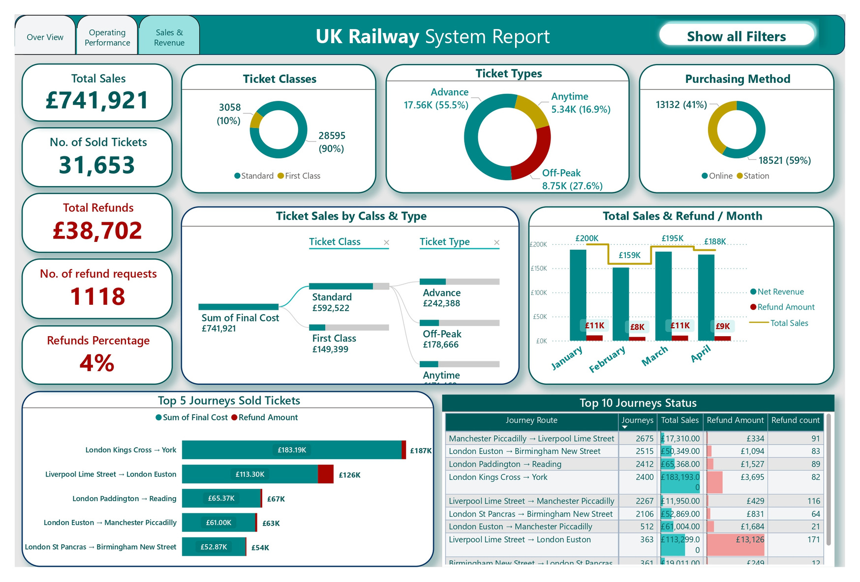
SALES
GOAL: ANALYZE REVENUE, TICKET SALES, AND PASSENGER BEHAVIOR.

Slide 12
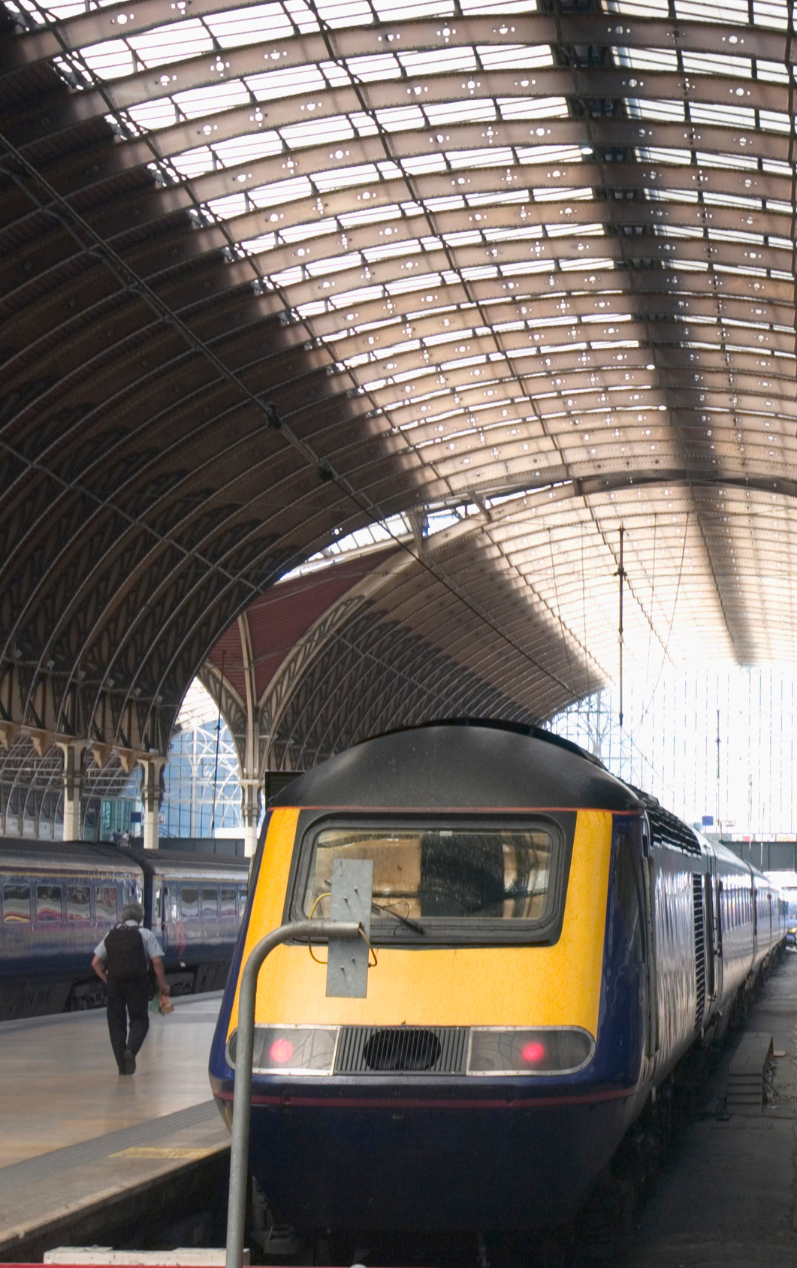
SALES
DASHBOARD
Total sales: £741,921
Standard Class tickets made up 80%
Advance tickets were the most popular with total sales £242K thus, it has the highest % of discount.
Purchases were almost evenly split between online (59%) and station sales (41%), showing the growing adoption of digital platforms.
Refunds accounted for £38,702, with 1,118 refund requests.

Slide 13



PERFORMANCE INSIGHTS
These are high-traffic routes, worth prioritizing for service improvements.
Busiest departure station: Manchester Piccadilly
Top destination station: Birmingham New Street
Highest traffic route:
Manchester ⟶ Liverpool
Operational performance is generally good, but delays still occur.
Most Journeys Are On Time by 87%.
Delays Reasons:
The top causes of all the reasons listed are:
Weather
Signal Failure
Technical Issues

Slide 14




SALES INSIGHTS
Passengers are price-sensitive; cost-efficient tickets drive demand.
Average ticket price: £23.44
Most Class Purchased: Standard class
The highest sales: Advance tickets by 55% sold with discount 50%. Anytime tickets are full price and flexible but have lower sales.
This shows most passengers prefer cheaper tickets over flexibility.
Digital channels are preferred, supporting investment in the online booking experience.
58% of tickets were bought online.
Most common payment methods: Credit Card and Contactless.
Either passengers are unaware of their eligibility, or the refund process is difficult.
Only about 27% of total eligible refunded transactions involved a refund request. we could boost customer satisfaction without significantly increasing refund costs

Slide 15

RECOMMENDATIONS
Offer promotions on less-busy routes.
Adjust prices slightly on consistently full journeys.
Promote digital platforms further (e.g., mobile app features like delay alerts, check-in, loyalty points).
Add personalization (e.g., frequently traveled routes, fastest trains).
Advertise and notify delayed passengers about refund eligibility.
Introduce a self-service refund request option in the app/website.

Slide 16




SUGGESTED FUTURE PLANS
-Launching recruitment events to increase the staff team.
-Develop training plans for the whole staff.
Due to data limitations, key questions around passenger capacity and pricing couldn’t be fully answered.
By providing detailed and well-descriptive data, we could launch loyalty campaigns, targeted ads, and offer discounts for families and children during holidays like Mother’s Day and national celebrations.
Set up 24/7 maintenance teams with smart tools for quick repairs. Keep stations clean and safe with regular checks. Maintain power, security, and passenger systems daily.

Slide 17
IMPLEMENTATION PHASE

Slide 18

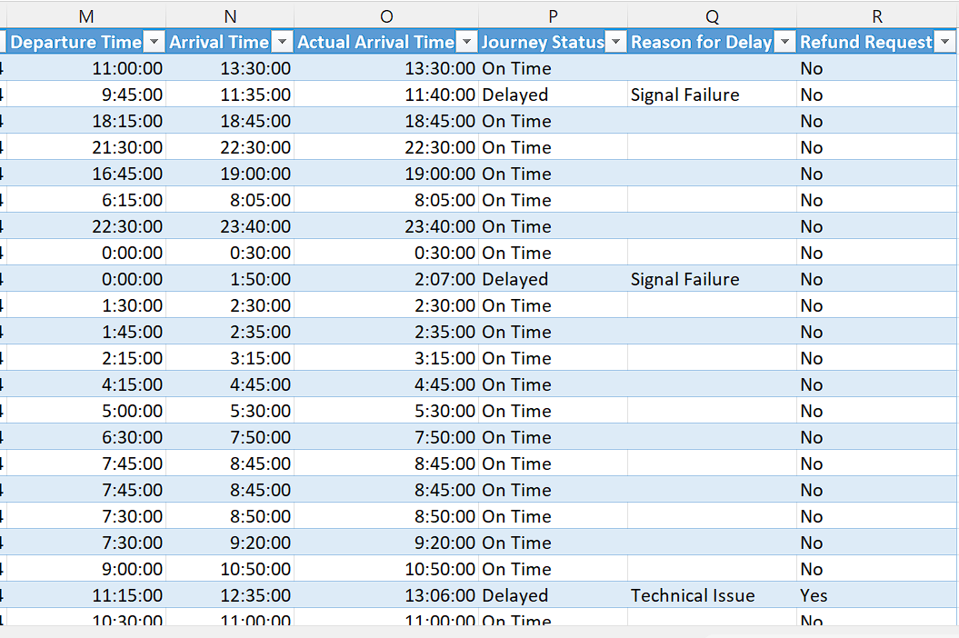
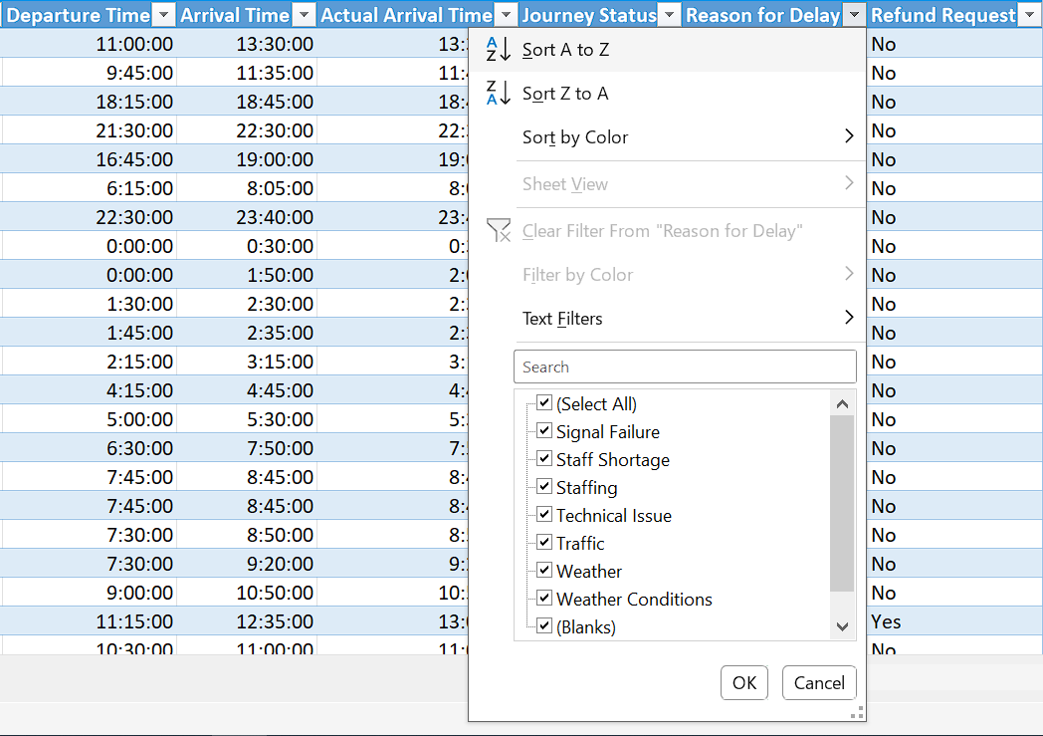

Data ” raw ”
The data in Reason for Delay Column has empty cells as the train arrived on time so there was no delay.
The values in Reason for Delay Column have duplicated values in a different spelling.

Slide 19
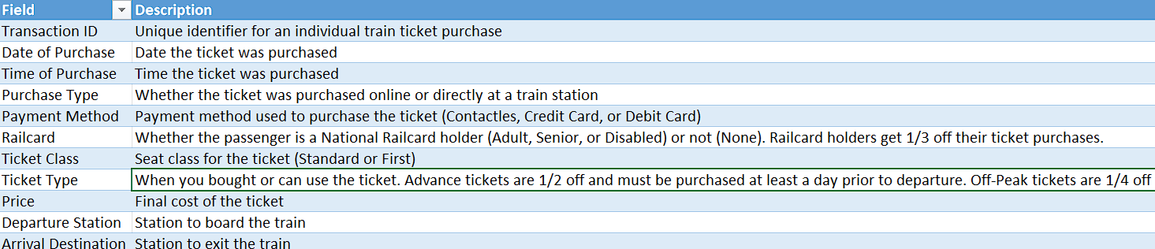
Data ” raw ”
In the metadata we found:
-The price column is the final cost after all discounts are applied.
-The discount applies when the passenger holds a Railcard or when purchasing a ticket of a specific type and time.

Slide 20
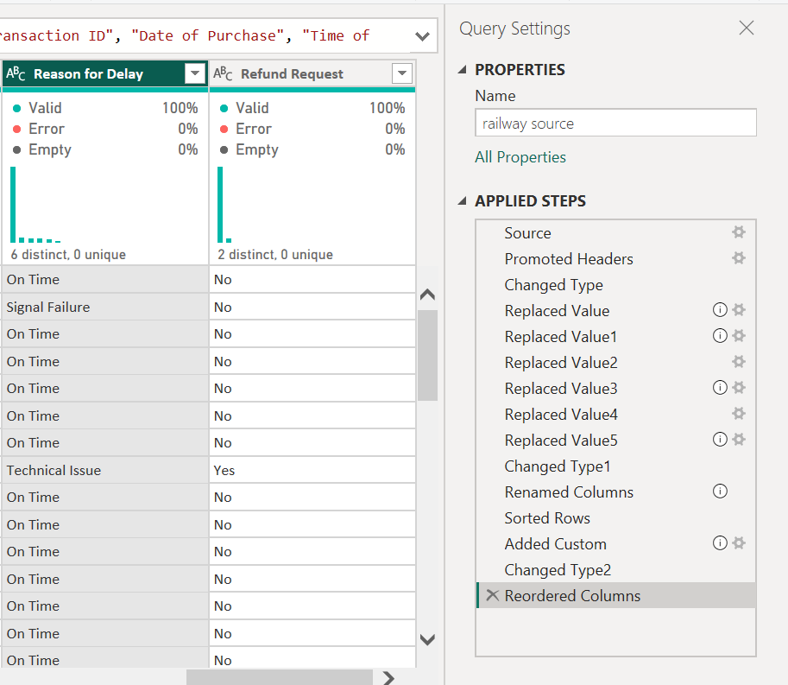
Data Cleaning
Reason for delay column:
Replaced nulls by “On Time”
Unify all the spelling duplicates into:
1. Signal Failure
2. Staffing Failure
3. Technical Issue
4. Traffic
5. Weather Conditions
8

Slide 21
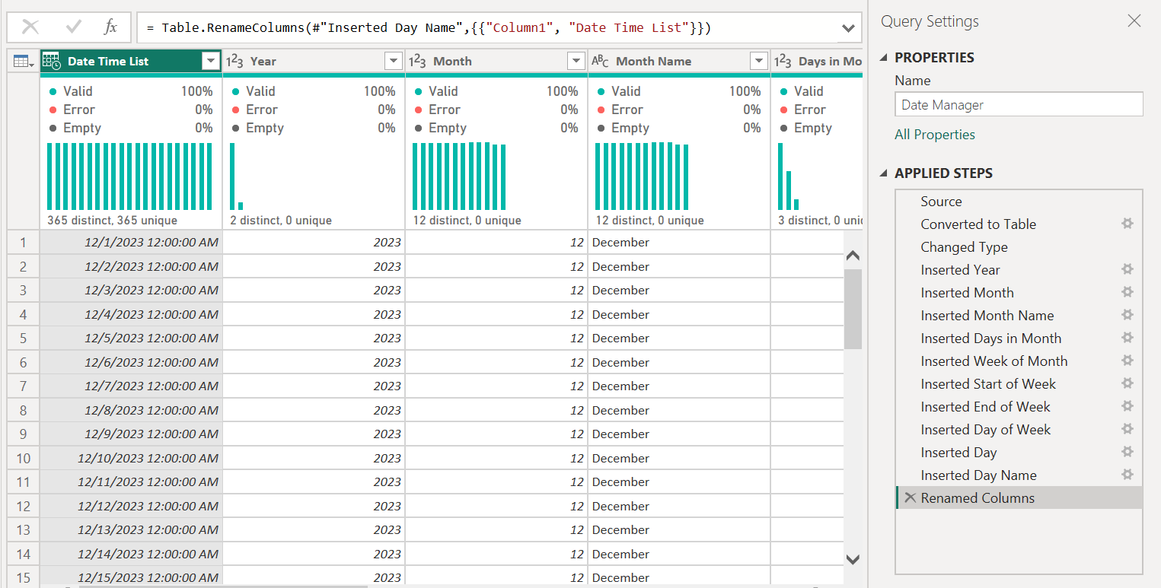
Power Query
Using Power Query to make a Date Manager Table to control the dates in the model… beginning with this formula
= List.Dates(#date (2023,12,1) ,365, #duration(1,0,0,0) )

Slide 22
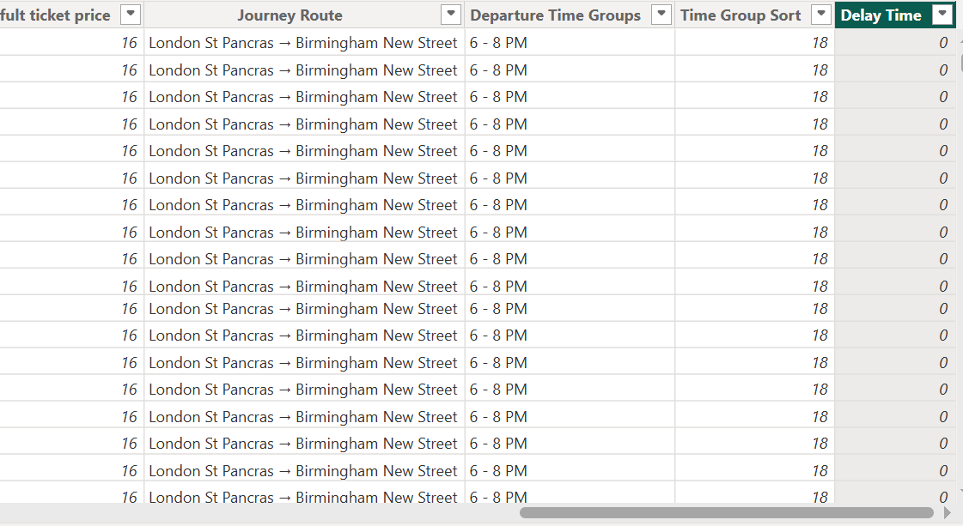
Data Cleaning
Delay Time:
Add a new column called delay time
Use DAX to measure the delay period in minutes
Delay Time =
DATEDIFF('railway source'[Arrival Time],'railway source'[Actual Arrival Time],MINUTE)

Slide 23
DAX
Used DAX to make some new calculations and make new columns and measures
busiest route =
VAR MaxRoute = MAXX(VALUES('railway source'[Journey Route]), [Journey Route])
RETURN
FIRSTNONBLANK(FILTER(VALUES('railway source'[Journey Route]), [Journey Route] = MaxRoute), 1)
-----------------------------------------------------------------------------
Avg. Delayed in Min. =
CALCULATE(
AVERAGE( 'railway source'[Delay Time] ),
'railway source'[Delay Time] <> BLANK())
-----------------------------------------------------------------------------
Net Revenue =
CALCULATE(SUM('railway source'[Final Cost]),'railway source'[Refund Request]="No")
11

Slide 24
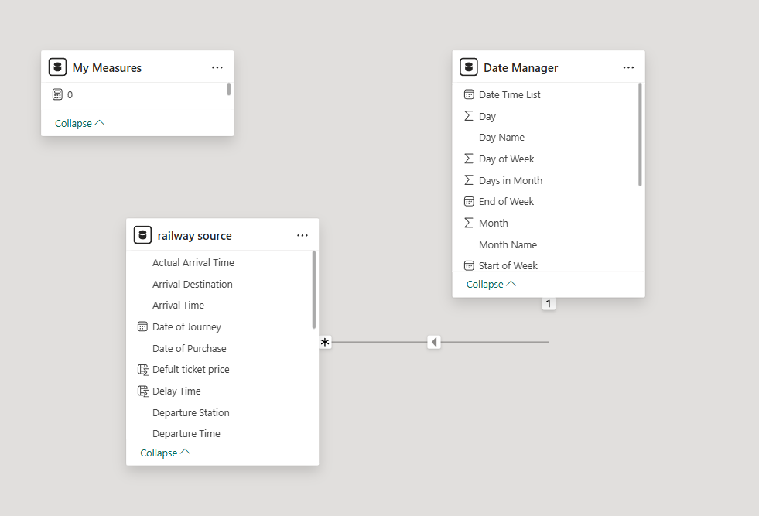
Model view
All tables are in relation and there was a hierarchy as shown below

Slide 25
ANY QUESTIONS?

Slide 26
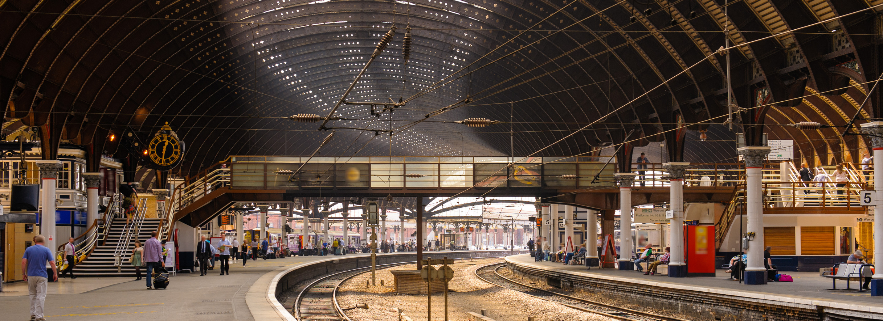



THANK YOU
GitHub
Google Drive
PowerBi.com

